Slide 1
Machine Learning Workshop
Jatin Katyal | Coding Blocks

Slide 2


Welcome!
Agenda for today!.
Basics of ML Understand the basics of Machine Learning.
Text Generation
Predict text using Markov Chains.

Slide 3

Machine Learning
Providing machines ability to learn & improve from experience!

Slide 4
Machine Learning
Providing machines ability to learn & improve from experience!

Slide 5
How they learn?
Supervised Learning
Unsupervised Learning
Reinforcement Learning

Slide 6
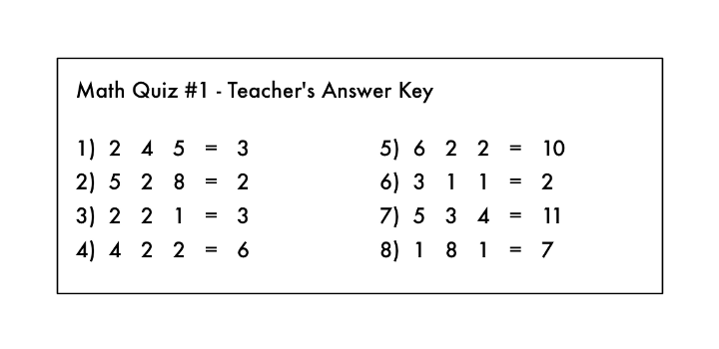
But how?
Machine learn some functions that map input X to some desired output Y.

Slide 7
Student Marks Prediction
You are given some input like
#assignment submitted
# hours of study
# marks in the previous semester
. MARKS = ASSIGNMENTS*2 + 8*HOURSSTUDY + MARKS IN THE PREV / C
.
This list of inputs in Machine Learning are called features.

Slide 8
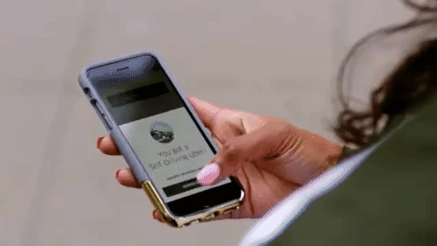
Autonomous Vehicles | Self Driven Cars

Slide 9
Input - ?
Output - ?

Slide 10
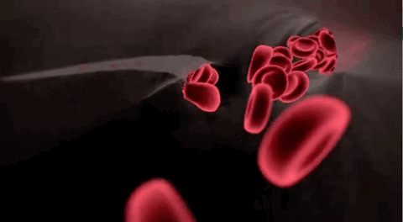
Health & Medicine
Blood Cells Detection

Slide 11
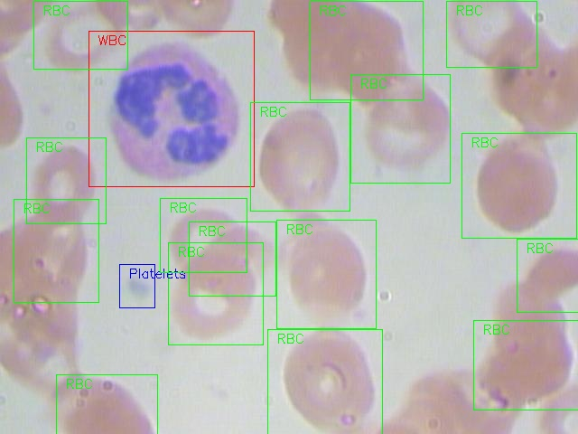
Input - ?
Output - ?

Slide 12
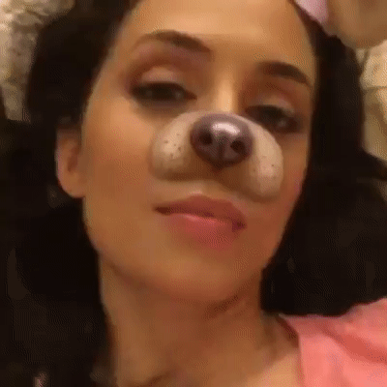
Landmark Detection
Snapchat

Slide 13
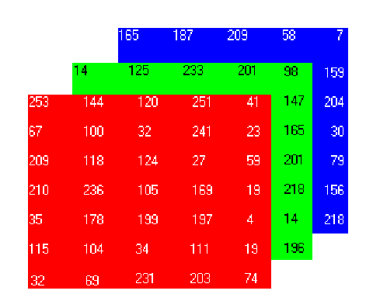
Why it is challenging?

Slide 14

Neural Art Transfer
PRISMA

Slide 15

Machine Learning is everywhere!
Email Filtering
Amazon Recommendations
Search Engines
Fraud Detection
Generating Art
Story Generation
Disease Diagnosis

Slide 16
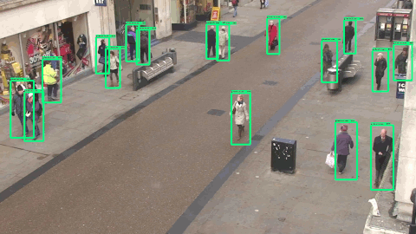
Machine Learning is everywhere!
Computer Vision
Autonomous Systems
Videos Surveillance for Crimes
Smart Cameras
Natural Language Processing
Personal Assistants like Google Allo
Text Generation/Autocomplete
Smart Speakers like Google Home

Slide 17
What we are going
to build?

Slide 18
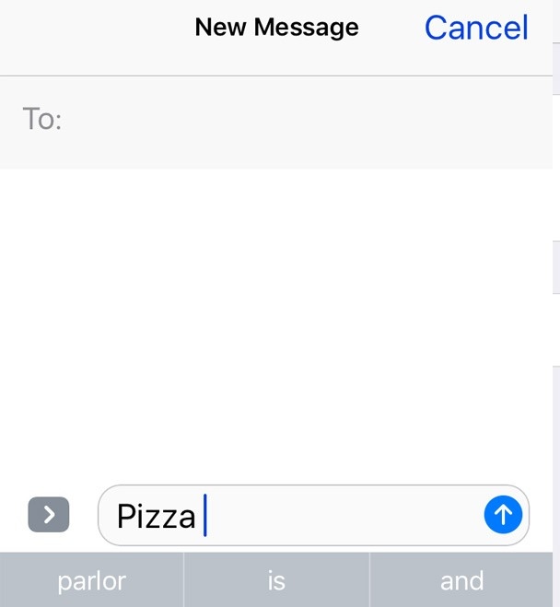
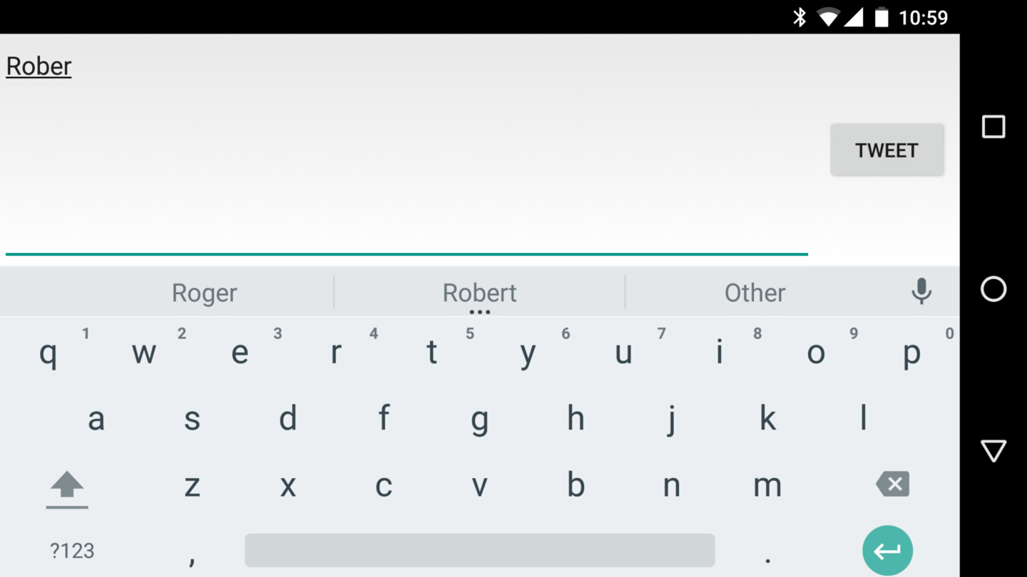
Language Generator!
(Using Markov Chains)

Slide 19

Text Generation
Markov Chains which is a probablistic concept.

Slide 20
Thank You!
Code Link: cblk/maitml
Contact: Jatin Katyal – jk@cb.lk
Github: jatinkatyal13

